Slide 1
Family Stress Theory
Smith Ch. 4

Slide 2
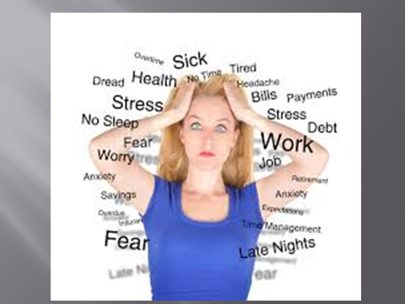

Slide 3
Basic Assumptions
A= stressor
B= resources or strengths
C= perception or meaning of the event
X= crisis
http://www3.uakron.edu/witt/fc/fcnote7.htm

Slide 4
Basic Assumptions
Stressor Events
  ________ Until Interpreted
  Both Positive and Negative Events Can Cause Stress
    Example of a positive event?
    Example of a negative event?

Slide 5
Basic Assumptions
  ___tress= negative stress
  ___tress= positive stress

Slide 6
Lipman-Bluman’s 8
Is the stressor internal or external to the family?
  Being fired vs. choosing to take time off
  Ice on the road vs. fear of losing control
  Others?

Slide 7
Lipman-Bluman’s 8
Is the stressor focused on one family member or all of them?
  One person bringing stress home from work vs. both spouses losing jobs due to economy

Slide 8
2. Is the stressor focused on one family member or all of them?
  Did I crash by myself or with my family?
  Other examples?

Slide 9
3. A sudden vs. gradual onset of the stressor.
  Unexpected illness vs. pregnancy
  Hitting black ice and crashing vs. slowly running out of gas
  Other examples?

Slide 10
4. Severity of the stressor
  Death of a child or the purchase of a new home?
  Rolled and totaled the car landing upside down in a ditch in the middle of winter vs. slight fender-bender
  Other examples

Slide 11
5. How long families have to cope with a stressor?
  First day of kindergarten vs. caring for a spouse with long-term cancer
  Broken arm vs. child with developmental disabilities

Slide 12
6. Whether the stressor is expected
  Expect challenges from adolescents vs. victim of a road-rage crime
  Did not expect to crash the car vs. expected to be sore and bruised from the accident.
  Childbirth vs. miscarriage.

Slide 13
7. Is the stressor natural or artificial/man made?
  Damage from Hurricane Katrina vs. loss of job due to a shifting economy
  Dealing with a heart attack vs. suicide or homocide.

Slide 14
7. Is the stressor natural or artificial/man made?
  Blame the accident on black ice covered with snow or driver error going too fast under unsafe conditions?

Slide 15
8. Does the family believe it can solve the crisis
  Step-family formation vs. terrorist attack
  I was sure we could get out of the totaled Ford Explorer vs. will I have a job after graduation?
  Other examples?

Slide 16
Boss (2002)
Normative vs. Non-normative
  Occurs in all families, can be anticipated and is short-term
  Examples?

Slide 17
Boss (2002)
Clear vs. Ambiguous
  The semester will last for 16 weeks vs. a writing assignment with no instructions
  A child diagnosed with a specific treatable disease vs. A child with random untreatable symptoms

Slide 18
Boss (2002) Cont.
Volitional vs. Non-Volitional
  Choosing your classes vs. being assigned what projects to do in those classes.
  Participate in sports vs. being injured due to not getting to choose your track events.

Slide 19
Boss (2002) Cont.
Chronic or Acute
  One that lasts a long time. E.g. caring for a child or elderly parent vs. babysitting the neighbors brat for an evening.
  Constant 20mph wind vs. a tornado

Slide 20
Resources-B
http://www3.uakron.edu/witt/fc/fcnote7.htm
The accident
Individual—cell phone, coat
Family—Wife willing to ask for help, father only 45 minutes away
Community—Oregon Highway patrol, Nurse traveling behind us, Towing service

Slide 21
Resources-B
Your event
Individual--?
Family--?
Community--?
Social Support?

Slide 22
Definition of the Situation-C
http://www3.uakron.edu/witt/fc/fcnote7.htm
How the stressor is interpreted is as important as access to resources in determining if the stressor will turn into a crisis.
Optimism and cognitive reframing help.
  How?
How do you write a 100 page paper?

Slide 23
Stress and Crisis--X
A B and C determine if a family is in crisis
http://www3.uakron.edu/witt/fc/fcnote7.htm
What are some crises that your family has overcome?

Slide 24
Definitions
“Discrete life events or transitions that have an impact upon the family unit and produce, or have the potential to produce, _____ in the family system”(19).

Slide 25
Definitions
One event at a time
Whether the event is positive or negative is up to interpretation
  What are some events that may be seen as positive or negative?

Slide 26
Coping = resources X perception
_______ actions→doing something about the situation
Intrapsychic coping→ _______ reframing of the problem
Emotional coping→processing the emotions related to the problem

Slide 27
Crisis
Stress causes change
Crisis rocks the foundation of the family
  Requires adjustment

Slide 28
Adaptation
Bonadaptation—a positive, healthy and functional result of the crisis
  Drive slowly in bad weather
  Other examples?

Slide 29
Adaptation
Maladaptation—a negative, unhealthy or dysfunctional resolution to the crisis
  Fly everywhere racking up credit card bills
  Other examples?

Slide 30
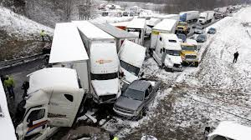
Pile-up

Slide 31
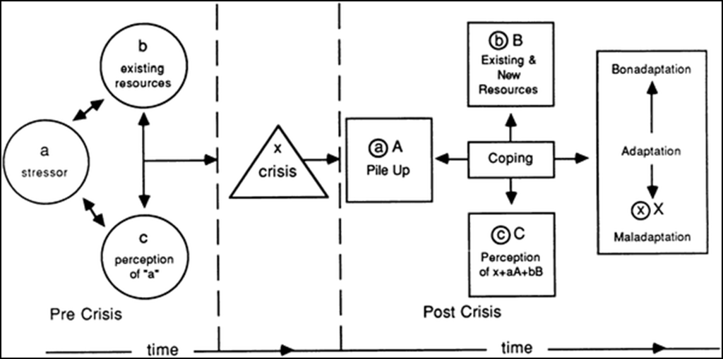

Slide 32
